Slide 1



Slide 2
“For 200 years we have said to the Indian people who are fighting for their land, their life, their families and their right to be free: ''Lay down your arms, my friends, and then we will remain together. Only if you lay down your arms, my friends, can we then talk of peace and come to an agreement which will be good for you.''
When they laid down their arms, we murdered them. We lied to them. We cheated them out of their lands. We starved them into signing fraudulent agreements that we called treaties which we never kept. We turned them into beggars on a continent that gave life for as long as life can remember. And by any interpretation of history, however twisted, we did not do right. We were not lawful nor were we just in what we did. For them, we do not have to restore these people, we do not have to live up to some agreements, because it is given to us by virtue of our power to attack the rights of others, to take their property, to take their lives when they are trying to defend their land and liberty, and to make their virtues a crime and our own vices virtues.
I would have been here tonight to speak to you directly, but I felt that perhaps I could be of better use if I went to Wounded Knee to help forestall in whatever way I can the establishment of a peace which would be dishonorable as long as the rivers shall run and the grass shall grow”

Slide 3
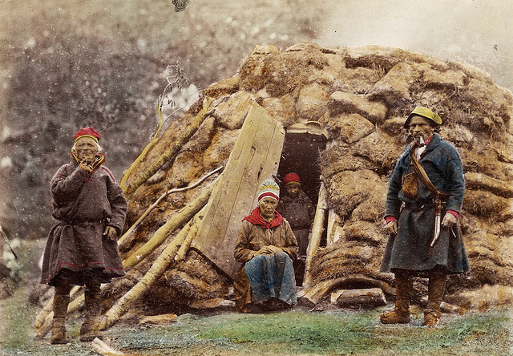
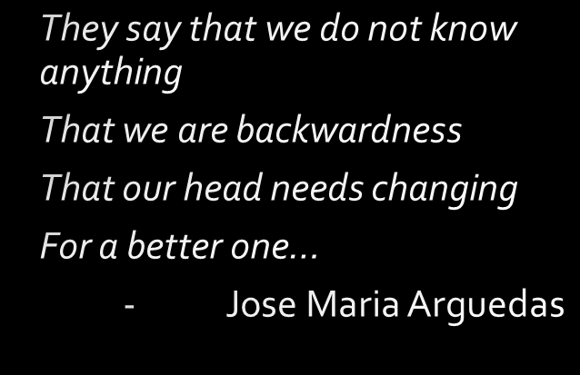
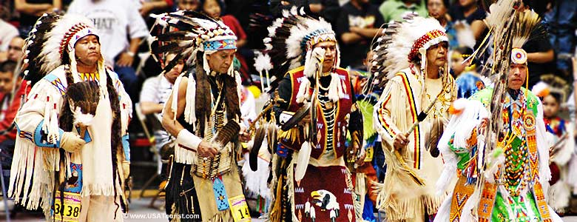

Slide 4
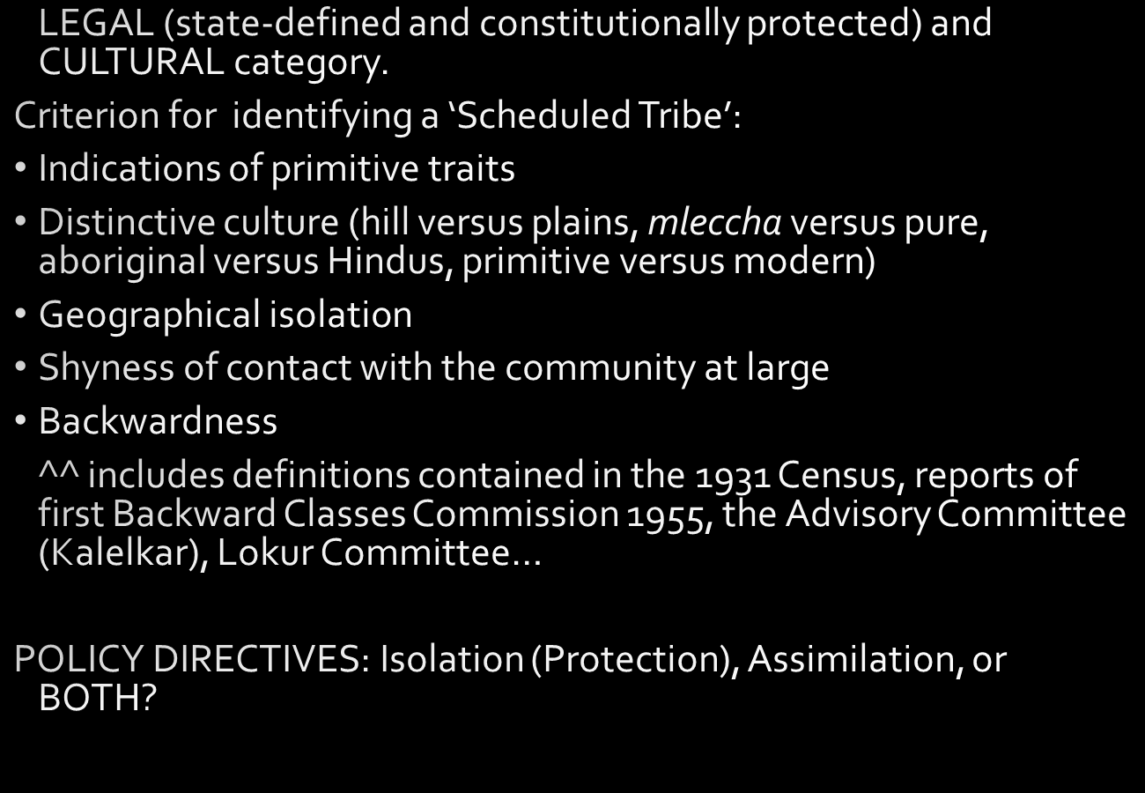

Slide 5
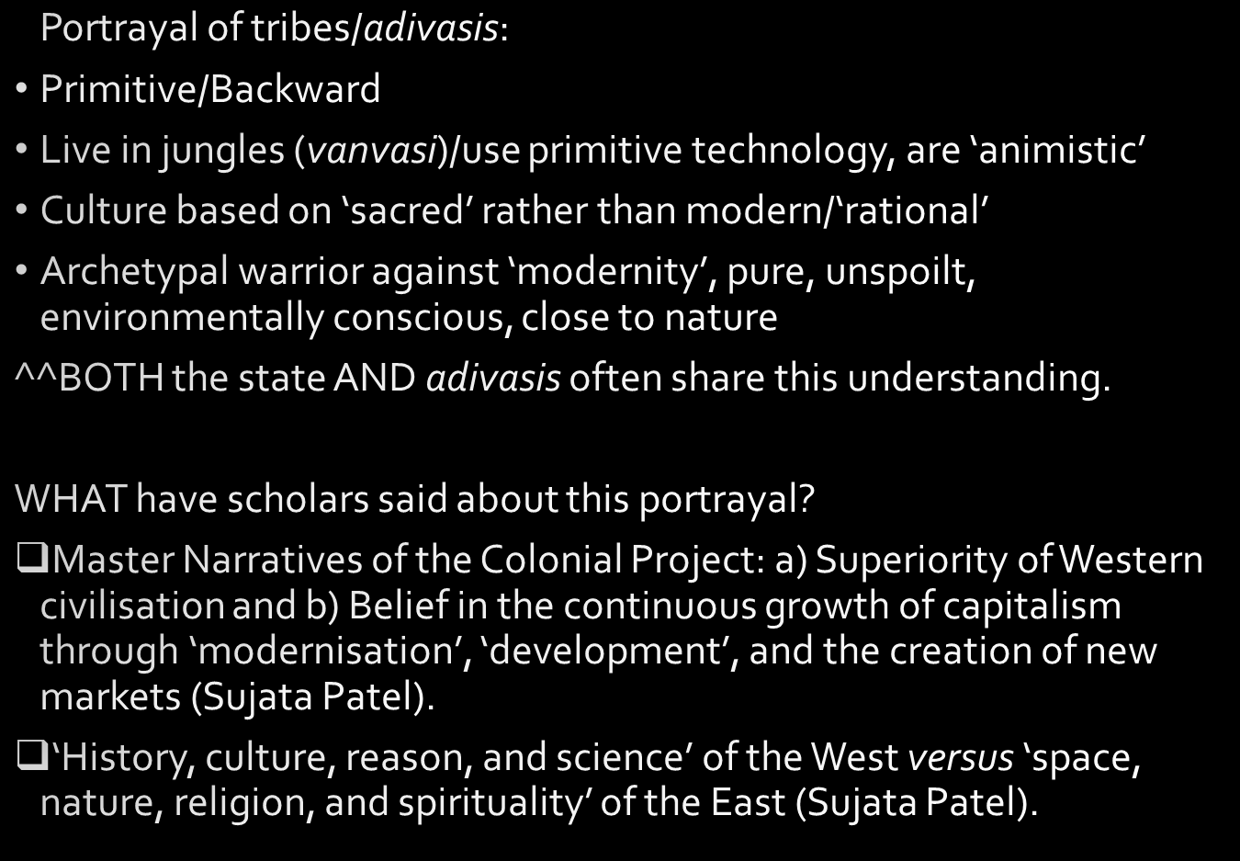

Slide 6
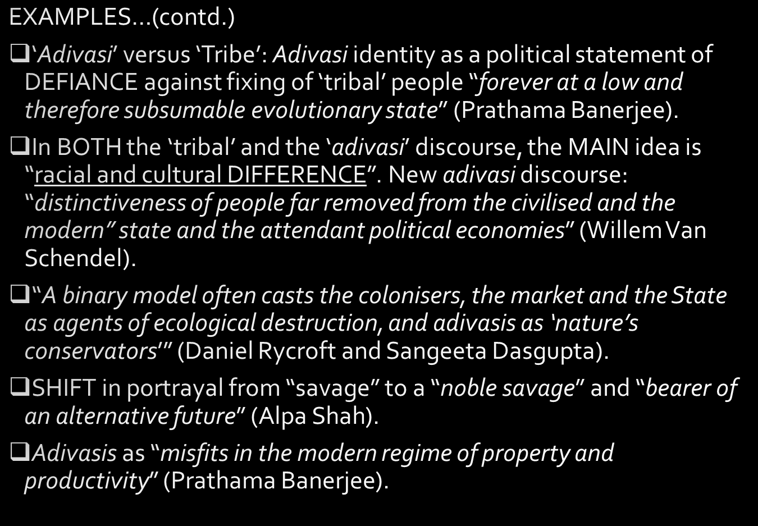

Slide 7
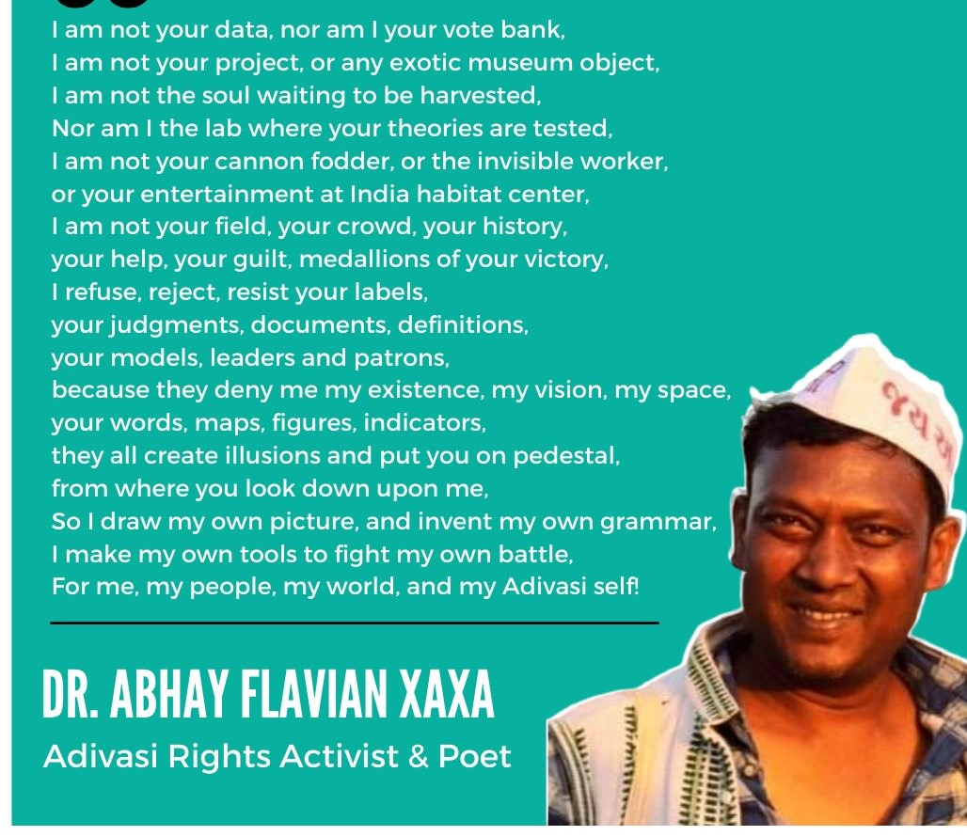

Slide 8
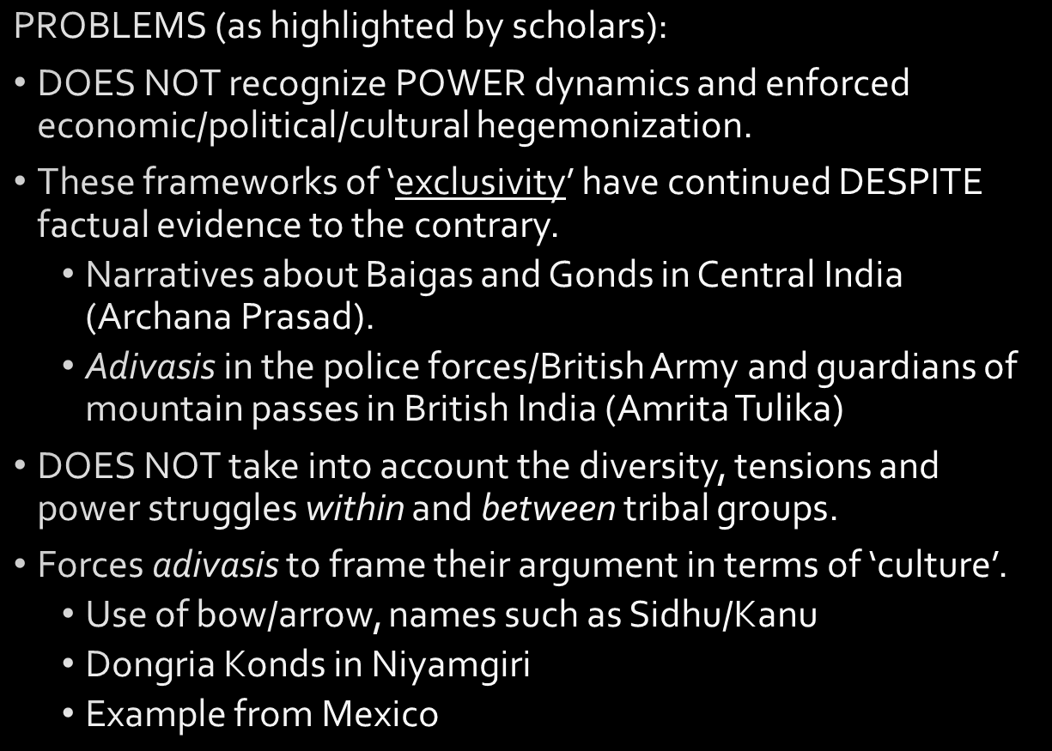

Slide 9
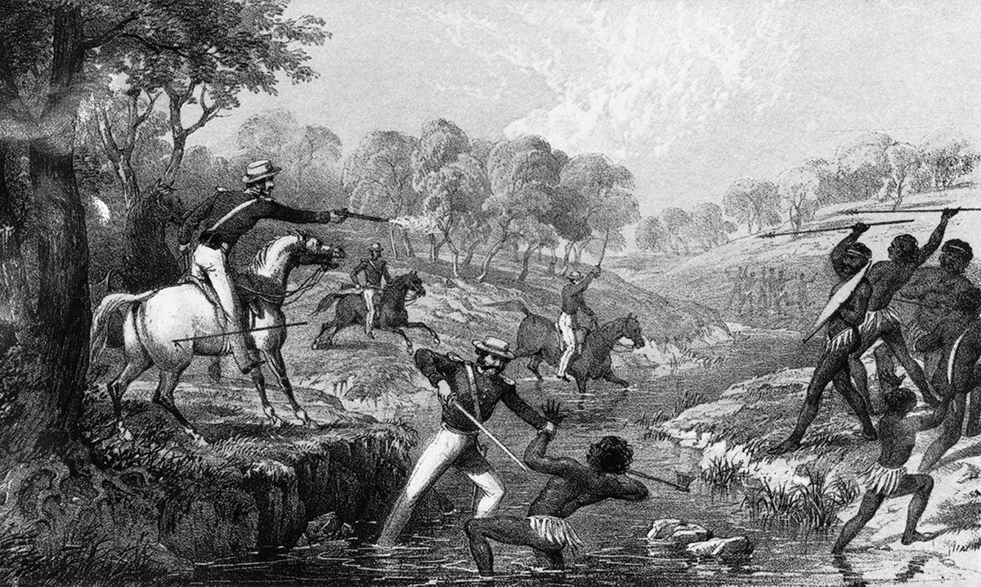

Slide 10
